Slide 1


MACHINE LEARNING ASSISTED
GENE EXPRESSION RESTORATION
CSE 6406
Arnob Saha Ankon – 1024052111
Arnab Bhattacharjee - 1024052106

Slide 2
Outline
Motivation
Literature Review
Objective
Methodology
Results
Discussion and Future Work
2

Slide 3
Outline
Motivation
Literature Review
Objective
Methodology
Results
Discussion and Future Work
2

Slide 4
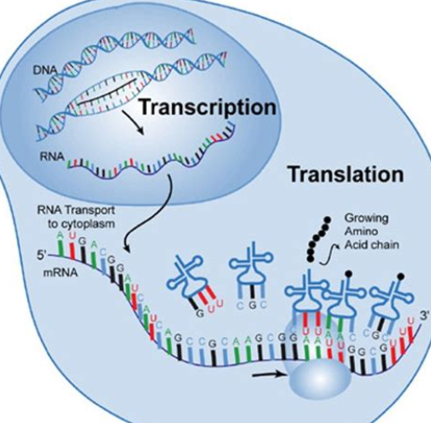
What is Gene Expression?
Gene expression is the process by which genetic information from a gene is used to produce a functional product, usually a protein.
Two stages:
  Transcription
  Translation
https://handsomescienceteacher.com/Online-science-classes-kids/wp-content/uploads/2022/10/transcription-and-translation.jpg
3

Slide 5
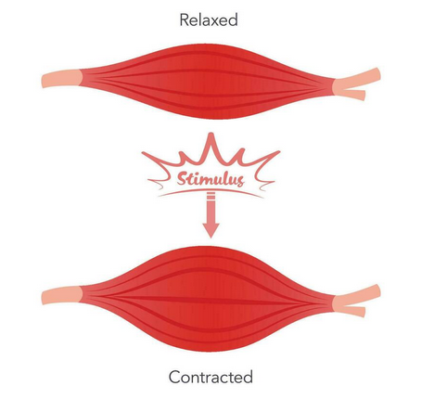
Gene Expression
Gene expression is essential for cellular functions, as proteins control most cellular processes.
Example: In muscle cells, genes responsible for muscle contraction are highly expressed, while in nerve cells, genes for signaling and neurotransmitter function dominate.
https://static.vecteezy.com/system/resources/previews/029/348/655/non_2x/skeletal-muscle-relaxation-and-contraction
4

Slide 6
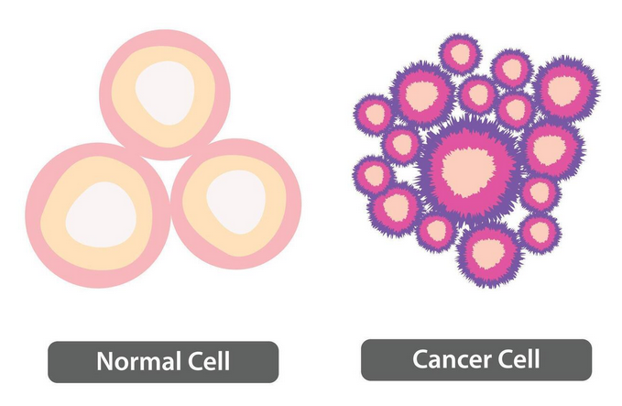
Gene Expression
Gene expression can be used to determine whether a cell is healthy or diseased.
Cell’s state:
  Source state
  Target state.
The changes between the source and target states occur because of the activation and repression of some of the genes present in the cell.
https://static.vecteezy.com/system/resources/previews/046/740/056/non_2x/normal-cell-vs-cancer-cell-loss-of-normal-growth-control-of-cell-healthy-tissue-and-tumor-illustration-vector.jpg
4

Slide 7
Gene Expression
Identification of the genes that drive the transformation from the source state to the target state is important, as this transformation enables early detection of diseases like cancer and tumors.
https://static.vecteezy.com/system/resources/previews/046/740/056/non_2x/normal-cell-vs-cancer-cell-loss-of-normal-growth-control-of-cell-healthy-tissue-and-tumor-illustration-vector.jpg
4

Slide 8
Gene Expression
Identification of the genes that drive the transformation from the source state to the target state is important, as this transformation enables early detection of diseases like cancer and tumors.
https://static.vecteezy.com/system/resources/previews/046/740/056/non_2x/normal-cell-vs-cancer-cell-loss-of-normal-growth-control-of-cell-healthy-tissue-and-tumor-illustration-vector.jpg
4

Slide 9
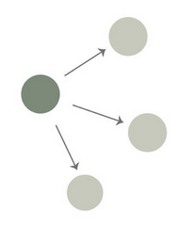
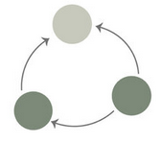
Gene Regulatory Network (GRN)
Gene
We can represent the complex relationships between genes and transcription factors that regulate and determine cell behavior using a gene regulatory network (GRN)
Regulatory
Relation
https://www.researchgate.net/publication/368589668/figure/fig2/AS:11431281125645060@1678379963003/The-topology-of-the-gene-regulatory-network-Note-The-dark-green-dots-indicate.jpg
6

Slide 10
Outline
Motivation
Literature Review
Objective
Methodology
Results
Discussion and Future Work
11

Slide 11
GAGER: gene regulatory network assisted gene expression restoration
Chowdhury, M.Z.U.S., Any, S.S., Samee, M.A.H. and Rahman, A. GAGER: gene regulatory network assisted gene expression restoration. bioRxiv, pp.2024-11.
This paper presents a method for identifying key transcription factors (TFs) whose perturbation can restore gene expression from a source state to target levels.
The authors assume a linear relationship between genes.
20

Slide 12
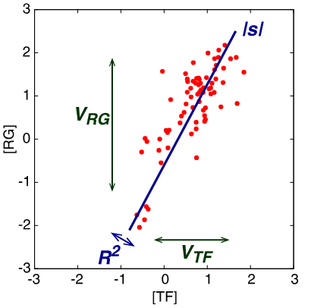
Relationship between regulatory pattern of gene expression level and gene function
Inoue, M. and Horimoto, K. Relationship between regulatory pattern of gene expression level and gene function. PLoS One. 2017 May 11;12(5):e0177430.
This paper shows that there are mainly four types of patterns between a TF and its regulated genes.
When there is a strong correlation between a TF and its regulated gene, only then they exhibit a linear relationship.
https://pmc.ncbi.nlm.nih.gov/articles/PMC5426767/pdf/pone.0177430.pdf
20

Slide 13
CellOracle: Dissecting cell identity via
network inference and in silico gene perturbation
Kamimoto, K., Stringa, B., Hoffmann, C.M., Jindal, K., Solnica-Krezel, L. and Morris, S.A., 2023. Dissecting cell identity via network inference and in silico gene perturbation. Nature, 614(7949), pp.742-75
CellOracle simulates changes in cell state in response to TF perturbations.
It uses custom GRN modeling to simulate global downstream shifts in gene expression following knockout (KO) or overexpression of TFs.
It considers cell identity as a dynamic property.
https://www.nature.com/articles/s41586-022-05688-9
20

Slide 14
Non-linear dynamic
Frank, T.D., Cavadas, M.A., Nguyen, L.K. and Cheong, A., 2016. Non-linear dynamics in transcriptional regulation: biological logic gates. In Nonlinear Dynamics in Biological Systems (pp. 43-62). Cham: Springer International Publishing.
Steinacher, A., Bates, D.G., Akman, O.E. and Soyer, O.S., 2016. Nonlinear dynamics in gene regulation promote robustness and evolvability of gene expression levels. PloS one, 11(4), p.e0153295.
https://link.springer.com/chapter/10.1007/978-3-319-33054-9_3
20

Slide 15
Limitation in ‘GAGER’
The relationship between a TF and its target gene is not always linear.
  Some TFs work in a cooperative manner
  Regulatory networks often involve feedback mechanisms
Example:
  Gal4 (TF in yeast) regulates genes involved in galactose metabolism. The relationship between Gal4 and gene expression can be approximately linear at low concentrations of Gal4. However, at high concentrations, the response becomes non-linear.
23

Slide 16
Outline
Background
Literature Review
Objective
Methodology
Results
Discussion and Future Work
24

Slide 17
Our Objective
Identification of the genes or TFs required to restore gene expression.
We are following the "GAGER" paper, but we assume that genes may have complex relationships rather than a linear one. Our goal is to identify these relationships and the relevant genes or TFs to restore gene expression.
Target Gene
6

Slide 18
Outline
Background
Literature Review
Objective
Methodology
Results
Discussion and Future Work
26

Slide 19
Overview
GRN and Difference Network
Gene Expression Matrix
Selecting TFs and genes
Comparison between inferred and target GRNs
Estimation of Gene Expression
and Regulatory Coefficients Assuming
Non-linear relationship
Inferring GRN
28

Slide 20
Overview
Parameterized regression
GRN and Difference Network
Gene Expression Matrix
Selecting TFs and genes
Comparison between inferred and target GRNs
Estimation of Gene Expression
and Regulatory Coefficients Assuming
Non-linear relationship
Inferring GRN
28

Slide 21
Outline
Background
Literature Review
Objective
Methodology
Results
Discussion and Future Work
51

Slide 22
Dataset
Hypoplastic Left Heart Syndrome (HLHS) RNA-seq data: Gene expression data from Omnibus GSE146341.
Progression of Neurodegeneration in Mouse Model RNA-seq data: Gene expression data from Omnibus GSE103334.
Saccharomyces cerevisiae RNA-seq data: Gene expression data from Omnibus GSM3564448 and Omnibus GSM4039308 .
54

Slide 23
Hypoplastic Left Heart Syndrome
54

Slide 24
Progression of Neurodegeneration
54

Slide 25
Outline
Background
Literature Review
Objective
Methodology
Results
Discussion and Future Work
64

Slide 26
Future Work
Abc
66

Slide 27
References
Hjhj
69

Slide 28
_{THANK YOU}

Slide 29
_{ANY} QUESTION?

